Slide 1

Social Buzz Analytics
Social media platform needs help scaling. Big data is a challenge. This report presents key findings and recommendations.
by Rini Chhabra
RC

Slide 2
The Challenge
Data Volume
Analysis Need
Massive volume of posts, 100k+ daily.
Difficult to process large data sets.
3.6 million posts annually.
Identify top 5 most popular categories.

Slide 3

Project Recap
Social Platform
San Francisco Based
Scaling Challenges
Established in 2010.
Large user base: 500 million.
Needs help to grow effectively.

Slide 4

Data Challenge
100K
3.6M
Daily Posts
Annual Posts

Slide 5


The Analytics Team
Rini Chhabra
Data Analyst

Slide 6
Data Analysis Process
1
Data Understanding
Initial understanding of the data.
Identify data types, formats, and relationships.
2
Data Cleaning
Handle missing values and outliers.
Ensure data consistency and accuracy.
3
Data Modeling
Create structures and relationships.
Prepare data for analysis.
4
Data Analysis
Apply statistical techniques to understand patterns.
Identify key insights and trends.
5
Insight Generation
Draw meaningful conclusions based on data.
Generate actionable recommendations.

Slide 7
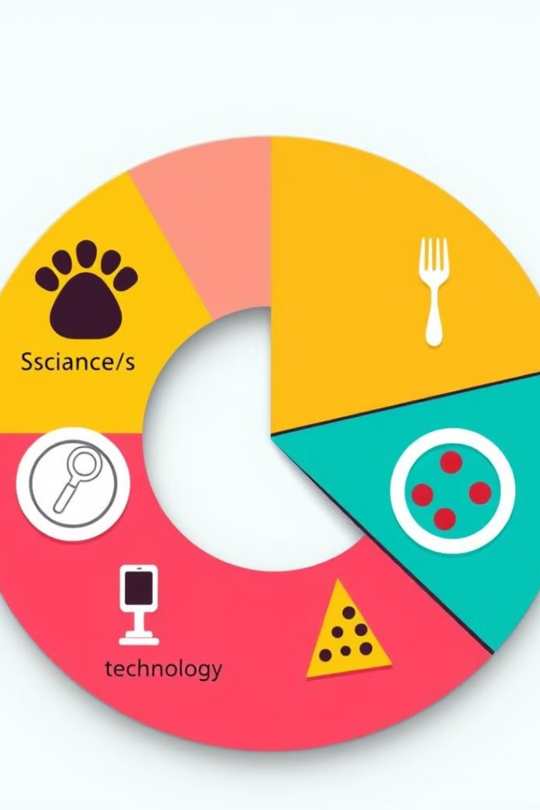
Key Insights
Top 5 Categories
Total Categories
Animal category dominates.
16 unique categories.
Science, healthy eating, technology, and food follow.
Post Count
May shows highest activity.

Slide 8
Top Categories
1
Animal
Most popular category.
2
Science
Second most popular.
3
Healthy Eating
Third most popular.
4
Technology
Fourth most popular.
5
Food
Fifth most popular.

Slide 9


Slide 10





Analysis Process Steps
Data Understanding
Identify data types, formats, and relationships.
Data Cleaning
Handle missing values and outliers.
Data Modelling
Create structures and relationships for analysis.
Data Analysis
Apply statistical techniques.
Insight Generation
Draw conclusions from the data.

Slide 11




Summary
Key Takeaways
1
Animal, science, and healthy eating are popular.
Content Strategy
2
Focus on visual content.
Seasonal Planning
3
May is a peak activity month.
Recommendations
4
Target popular categories.

